Slide 1


BANK NIFTY ANALYSYS
Poonam Patil
GitHub : https://github.com/Poonam-Patil-29/Bank-Nifty-Analysys-Using_Spark
Rohit Shreeya

Slide 2
TECHONOLOGIES USED
Language : Python
Environment : Jupyter Notebook
Modules and Libraries : Pyspark, matplot, seaborn, Findspark

Slide 3
INTRODUCTION
The project aims to analyze the historical data of Bank Nifty, including stock prices and other financial metrics, using Spark's powerful analytics capabilities. Bank Nifty is an index that represents the performance of the banking sector in the Indian stock market.
The project's ultimate goal is to create a robust and accurate predictive model that can assist investors and traders in making informed decisions regarding their investments in the banking sector.

Slide 4
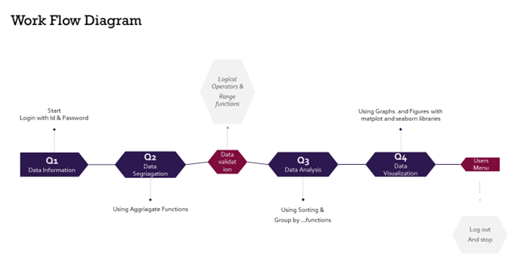
WORK FLOW DIAGRAM

Slide 5
Thank You

